Slide 1
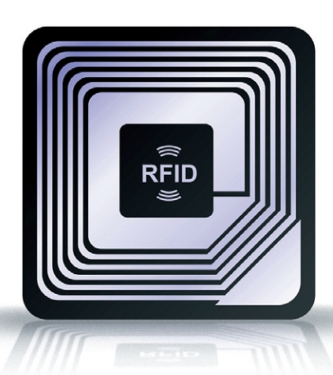
RADIO FREQUENCY IDENTIFICATION AND ITS APPLICATIONS
Dr. K. Vairamani,
Assistant Professor,
Department of Electronics,
St. Joseph’s College (Autonomous),
Tiruchirappalli – 620 002.
E-mail: vairamani_electro@yahoo.com
Cell: 9943147283

Slide 2
Outline
What is RFID?
Need for RFID
Active and passive tags
Typical applications
RFID products
Manufacturers in India
Common problems in RFID

Slide 3
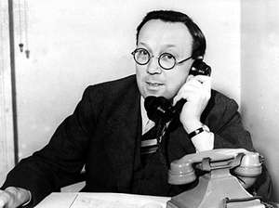
History of RFID
The first known application of RFID was done in World War II where in RFID was used to identify the planes (enemy or own) using radar.
In 1935 under Scottish physicist Sir Robert Alexander Watson-Watt, who headed a secret project, the British developed the first active identify friend or foe (IFF) system.
They put a transmitter on each British plane. When it received signals from radar stations on the ground, it began broadcasting a signal back that identified the aircraft as friendly.
RFID works on this same basic concept. A signal is sent to a transponder, which wakes up and either reflects back a signal (passive system) or broadcasts a signal (active system).

Slide 4
Mario Cardullo's passive radio transponder device in 1973 was the first true ancestor of modern RFID.
Commercial applications began in 1980.

Slide 5
What is RFID?
RFID is a common term employed to describe a device which is employed in transferring data with the help of radio waves.
RFID is the wireless non-contact use of radio frequency electromagnetic fields to transfer data, for the purpose of automatically identifying and tracking objects attached to it.
RFID devices is used as a substitute of bar code or a magnetic strip which is noticed at the back of an ATM card or credit card, it gives a unique identification code to each item.
Similar to the magnetic strip or bar code, RFID devices too have to be scanned to get the details (identifying information).

Slide 6
Need for RFID
A fundamental advantage of RFID gadgets above the other stated devices is that the RFID device is not required to be placed exactly near to the scanner or RFID code reader.
As all of us are well aware of the difficulty which store billers face while scanning the bar codes and but obviously the credit cards & ATM cards need to be swiped all though a special card reader.
RFID device can function from few feet away (approx 20 feet for high frequency devices) of the scanner machine.
Avoid duplication

Slide 7
RFID vs. Barcode
Advantages of RFID
Efficiency: RFID can scan multiple items at once
Durability: RFID can handle exposure to sun & rain
RFID allows for greater security than barcodes
Disadvantages of RFID
Materials like metal & liquid can impact signal
Sometimes not as accurate or reliable as barcode scanners
Cost – RFID readers can be 10x more expensive than barcode scanners
Implementation can be difficult & time consuming

Slide 8
Basic components of an RFID System
The transponder or tag can be either active of passive tag. It reacts to the signals from the reader or writer or interrogator which in turn conveys signals to the computer.

Slide 9
RFID Tags
RFID tags comprise of a RFID transceiver for transferring data from one system to another.
There are 2 kinds of RFID tags
Active tags
Passive tags.

Slide 10
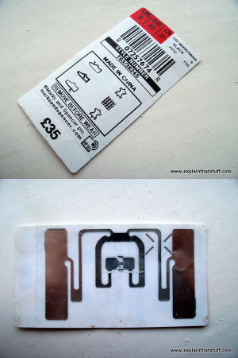
Passive RFID Tags
Passive tags comprise of 3 key components
an in-built chip: generates a unique identifier code for the particular tag
an antenna: catches incoming radio waves and sends them back out again
a substrate: The backing material (typically paper or Plastic) to which the antenna and chip are fixed
Passive RFID tags are smaller in size as well as cheap.

Slide 11
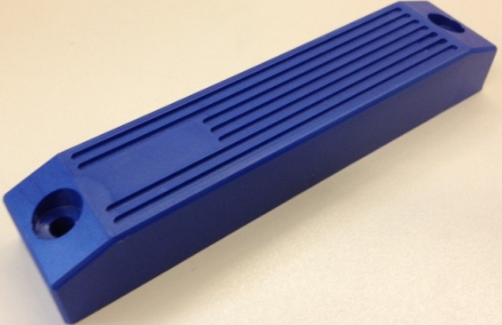
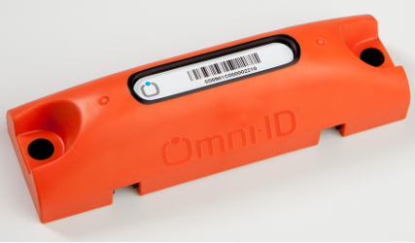
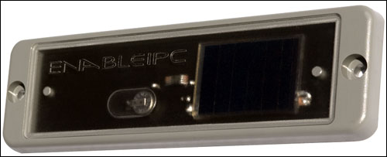
Active RFID Tags
Active tags comprise of same components that exists in passive tags and is incorporated with a built-in power supply.
an internal battery that enables them to have extremely long read ranges as well as large memory banks. Maximum of the active tags make use of batteries whereas some of them work on solar cells.
Typically, active RFID tags are powered by a battery that will last between 3 – 5 years, but when the battery fails, the active tag will need to be replaced. As the active tag market matures, replaceable batteries will be a cost saving option. The system’s functionality depends entirely on the type of tag chosen for the application.
The inbuilt power system facilitates the tag to be used as an independent reader which is competent of transferring information devoid of outer assistance.

Slide 12
Different types of active tags
Transponders
In an active transponder tag, the reader (like passive systems) will send a signal first, and then the active transponder will send a signal back with the relevant information.
Transponder tags are very efficient because they conserve battery life when the tag is out of range of the reader.
Commonly used in secure access control and in toll booth payment systems.
Beacons
In a system that uses an active beacon tag, the tag will not wait to hear the reader’s signal.
Instead, true to its name, the tag will ‘beacon’, or send out its specific information every 3 – 5 seconds.
Beacon tags are very common in the oil and gas industry, as well as mining and cargo tracking applications.
Active tag’s beacons can be read hundreds of meters away, but, in order to conserve battery life, they may be set to a lower transmit power in order to reach around 100 meters read range.

Slide 13
Read only and R/W tags
Read Only (RO)
RO tags are preprogrammed with a unique number like a serial number
Write Once Read Many (WORM) or Read Write (RW).
WORM tags are pre-programmed but additional information can be added to tags.
RW tags can be updated dynamically. Most library applications use RW tags.

Slide 14
Unique identification code
RFID tag has got a Unique Identification code called UID.
LF RFID tags that operates in the 125-134KHz spectrum, the UID is a Read-Only number with 64 bit in length.
HF RFID tags that operates in the 13.56MHz HF spectrum the UID again is a Read-Only number with 64-bit in length.
UHF tags has read/write capabilities with ID size between 32-64 bit in length.

Slide 15
RFID operating frequency
Low Frequency (LF) 125-135 KHz
High Frequency (HF) 13.56 MHz
Ultra High Frequency (UHF) 868-930 MHz
Microwave or Super high frequency (SHF) 2.45 GHz and 5.8 GHz

Slide 16
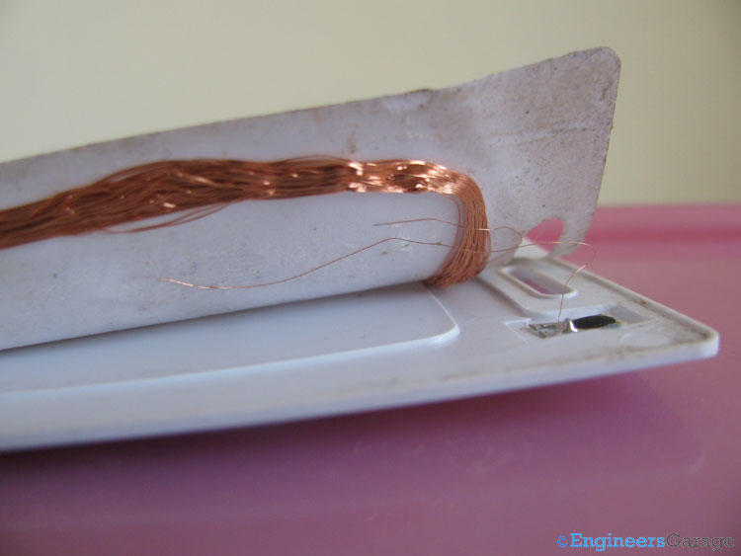
125 KHz RFID clamshell card
When a 125kHz card is powered up, it immediately begins to transmit its card number.

Slide 17
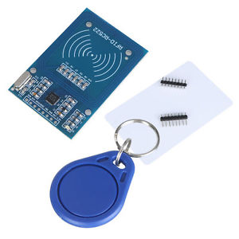
Mifare
The Mifare standard was originally created as a ticketing solution for transport systems, and at the same time addressed the security issues in 125kHz technology by enabling two way communication between the card and reader. This saw the introduction of card encryption and the ability to store data on the card.
Mifare technologies store the card number in one of the storage areas on the card, known as sectors. When the card approaches the RF field of the reader, the card and reader begin a secure communication session using shared encryption keys.

Slide 18
RFID Applications
Tracking Books in Libraries
Authorized building access (Prox Cards)
Passports (US passports recently)
Prison inmates (embedded)
For toll booths (or any “pay for entry” system)
Airport Baggage ID
Car keys, wireless entry and ignition
Animal tracking and livestock tracking
Logistics
Retails
Shoes, clothes, cell phones, food products
Hospital Patients
Instant history tracking

Slide 19
RFID Standards and specifications
Tracking Animals
ISO 11784 – Specifies the structure of the ID code
ISO 11785 – Specifies how transponder is activated
ISO 14223/1 – Specifies RF code for advanced transponders
Credit Cards
ISO 15693 – Specifies modulation and coding schemes
Passports and proximity cards
ISO 14443 – Specifies modulation and coding schemes
General Frequency bands
ISO 18000 series

Slide 20
Standard RFID Operating Frequencies
ISO 18000-2
<135 KHz
ISO 18000-3
13.56 MHZ
ISO 18000-4
2.45 GHz
ISO 18000-6
860-960 MHz
ISO 18000-7
433 MHZ (active)

Slide 21
RFID enabled products
NFC Sticker
Wrist band
RFID Smart card
Laundry tag
Metal mount tag
Nail tag
Tire tag

Slide 22
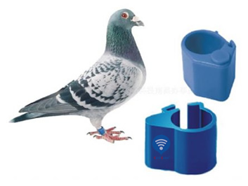
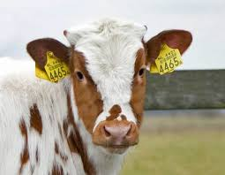
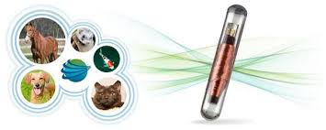
Animal tracking
Foot ring tag
Electronic ear tags
Implant glass tags

Slide 23
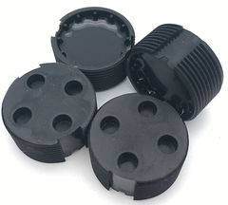
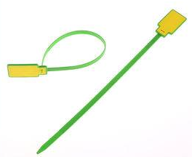
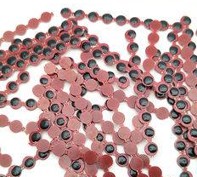
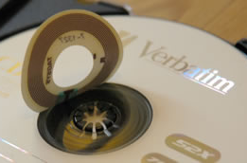
RFID Waste bin tag
Security cable seal tag
Key tag
Epoxy tag
Specialty tag
Token tag

Slide 24
RFID in library management

Slide 25
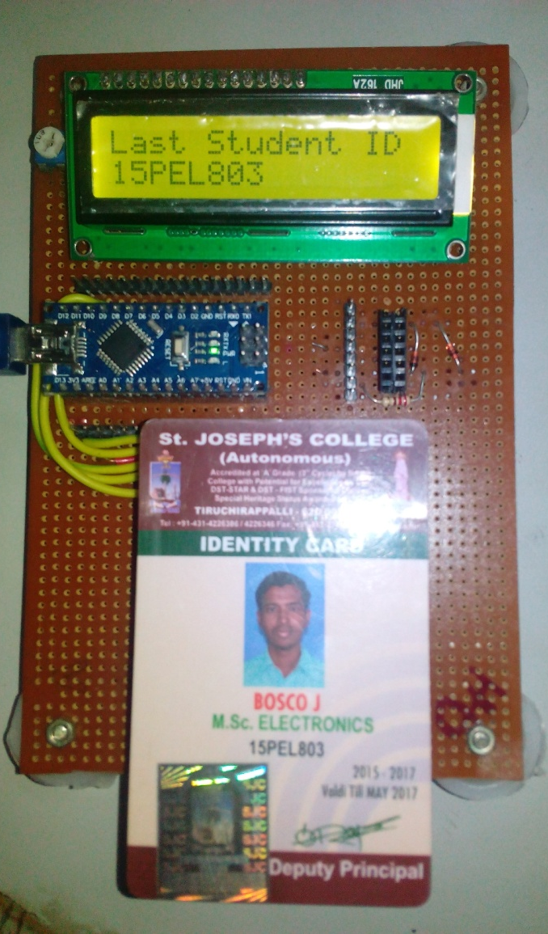
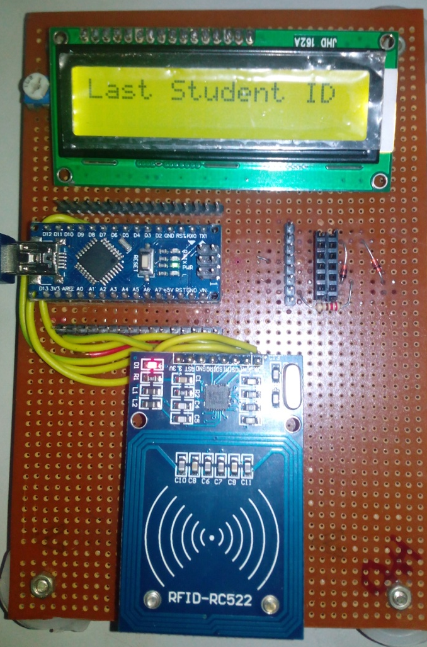
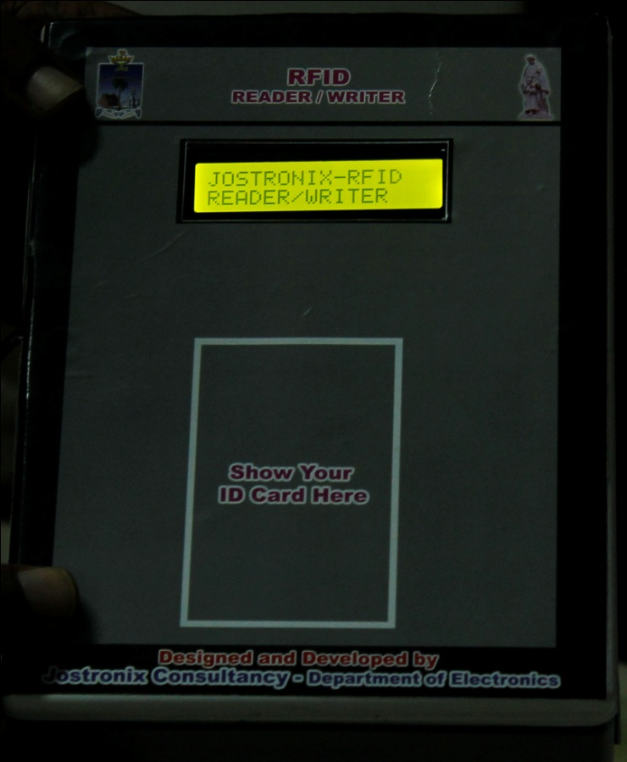

Slide 26
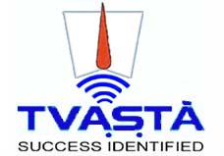
RFID Manufacturers in India

Slide 27
Common problems with RFID
Reader collision.
Tag collision.

Slide 28
Present scenario
In Osaka, Japan school childrens’ garments are being chipped with RFID.
A monitoring system in Doncaster England, tracks kids by radio chips placed in their uniforms.
US Healthcare had adopted methods of using both active and passive RFID technology to collect and monitor patient medical activity for nearly a decade.

Slide 29
RFID and IoT

Slide 30
Questions?

Slide 31
Thank you

